Slide 1
Relational Database Management System (RDBMS)
240110102

Slide 2
Database Architecture
The DBMS design depends upon its architecture. The basic client/server architecture is used to deal with a large number of PCs, web servers, database servers and other components that are connected with networks.
The client/server architecture consists of many PCs and a workstation which are connected via the network.
DBMS architecture depends upon how users are connected to the database to get their request done.

Slide 3
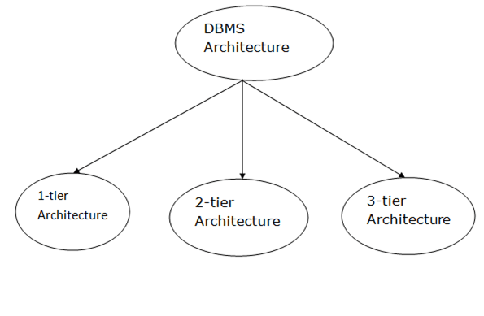

Slide 4
1-Tier Architecture
In this architecture, the database is directly available to the user. It means the user can directly sit on the DBMS and uses it.
Any changes done here will directly be done on the database itself. It doesn't provide a handy tool for end users.
The 1-Tier architecture is used for development of the local application, where programmers can directly communicate with the database for the quick response.
Advantages:
simplicity, cost-effectiveness, and ease of deployment,
Particularly used for small-scale or personal databases.
It's also known for faster data access for a single user due to the absence of network communication overhead
Limitations:
lacks scalability, challenges in data sharing
support a single user at a time, making it unsuitable for most modern applications.

Slide 5
2-Tier Architecture
The 2-Tier architecture is same as basic client-server. In the two-tier architecture, applications on the client end can directly communicate with the database at the server side. For this interaction, API's like: ODBC, JDBC are used.
The user interfaces and application programs are run on the client-side.
The server side is responsible to provide the functionalities like: query processing and transaction management.
To communicate with the DBMS, client-side application establishes a connection with the server side.
Advantages:
simplicity and direct client-server communication.
Key benefits include ease of access, scalability, cost-effectiveness, and simple deployment
Limitations:
scalability, security, and maintainability.
It's generally not suitable for large, complex applications with many users due to performance bottlenecks and security vulnerabilities.

Slide 6
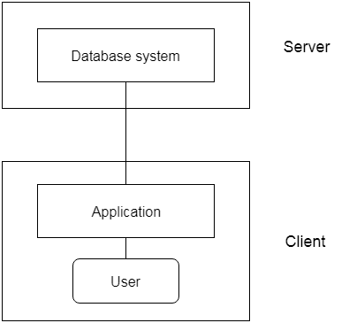

Slide 7
3-Tier Architecture
The 3-Tier architecture contains another layer between the client and server. In this architecture, client can't directly communicate with the server.
The application on the client-end interacts with an application server which further communicates with the database system.
End user has no idea about the existence of the database beyond the application server. The database also has no idea about any other user beyond the application.
The 3-Tier architecture is used in case of large web application.
Advantages:
By separating the application into three distinct layers (presentation, application, and data), it allows for independent scaling, enhanced security protocols, and easier updates and modifycations
Limitations:
increased complexity, potential performance bottlenecks due to increased network traffic,
higher development and maintenance costs, and reduced agility compared to simpler architectures

Slide 8
